Slide 1

Go’s Context Library
By:
Smita Vijayakumar

Slide 2
1
Introduction
Context Management in Distributed Systems
Go’s Context Library
Example Use case
Points to Watch Out For
Agenda
2
3
4

Slide 3
Introduction

Slide 4

Distributed Data Flow

Slide 5

Request Processing
A
RPC
B
RPC
C
RPC
D
RPC
E

Slide 6
Defines *Context* type
Carries request-scoped values:
Deadlines
Cancellation signals
Others
Go Context

Slide 7
Works across API boundaries
Also between processes
Included as the first parameter
Go Context

Slide 8
Details
//golang.org/x/net/context
type Context interface {
Done() <-chan struct{} Err() error Deadline() (deadline time.Time, ok bool) Value(key interface{}) interface{} }

Slide 9
Primary
Use Cases
Distributed Tracing
Request Cancellation
Context value

Slide 10
Example 1 - Distributed Tracing
struct ContextValue {
requestID string
}

Slide 11
Background Node
Value Node
Cancellable Node
TODO() Node
Types of
Context Nodes

Slide 12
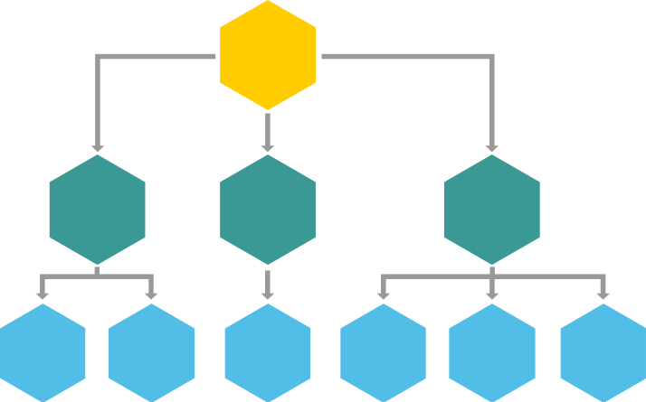
Types - A Context Tree
Example -
A = context.Background()
B, cancelB = context.WithCancel(A)
C = context.WithValue(A, “C Key”, “C”)
D = context.WithValue(A, “D Key”, “D”)
E, cancelE = context.WithTimeout(B, timeout)
..
A
Background
Context
B
C
D
With
Cancel
With
Value
With
Value
E
F
G
H
I
J
With
Timeout
With
Value
With
Value
With
Value
With
Value
With
Value

Slide 13
Example 2 - UTIL Package
package userid
const ctxKey string = “UserID”
func SetContextValue(ctx context.Context, id int) context.Context {
return context.WithValue(ctx, ctxKey, id)
}
func GetContextValue(ctx context.Context) (int, bool) {
id, ok := ctx.Value(ctxKey).(int)
return id, ok
}

Slide 14
Example 2 - Cancellable Request - Set the Context
package request
func startRequest(event *event.Event, timeout time.Duration) error {
ctx, cancel :=
context.WithTimeout(context.Background(), timeout)
defer cancel()
//…
ctx = util.SetContextValue(ctx, id)
status, err := processor.Server(ctx, event)
//…
}

Slide 15
Example 2 - Cancellable Request - Set the Context
package request
func startRequest(event *event.Event, timeout time.Duration) error {
ctx, cancel :=
context.WithTimeout(context.Background(), timeout)
defer cancel()
//…
ctx = util.SetContextValue(ctx, id)
status, err := processor.Server(ctx, event)
//…
}

Slide 16
Example 2 - Cancellable Request - Set the Context
package request
func startRequest(event *event.Event, timeout time.Duration) error {
ctx, cancel :=
context.WithTimeout(context.Background(), timeout)
defer cancel()
//…
ctx = util.SetContextValue(ctx, id)
status, err := processor.Server(ctx, event)
//…
}

Slide 17
Example 2 - Cancellable Request – Get and Handle Context
package processor
func Server(ctx context.Context, event *event.Event) error {
if id, ok := util.FromContext(ctx); !ok { return errors.New(“Not a valid ID to process”) }
p := make(chan error, 1)
go func(ctx context.Context, id int,
event *event.Event) {
p <- processEvent(ctx, id, event)
}()

Slide 18
Example 2 - Cancellable Request – Get and Handle Context
package processor
func Server(ctx context.Context, event *event.Event) error {
if id, ok := util.FromContext(ctx); !ok { return errors.New(“Not a valid ID to process”) }
p := make(chan error, 1)
go func(ctx context.Context, id int,
event *event.Event) {
p <- processEvent(ctx, id, event)
}()

Slide 19
Example 2 - Cancellable Request – Get and Handle Context
//continued
select {
case <-ctx.Done():
//…
return ctx.Err()
case err := <-p
return err
}
}

Slide 20
1. Ease of handling multiple,
concurrent requests
Summary -
Use Cases In Distributed System
2. Flow Traceability and
Fingerprinting
3. Time Sensitive and Cancellable
Request Processing
Ease of sending context information

Slide 21

Remember!

Slide 22
Code Complexity:
Remember…
For larger systems, complexity is the downside

Slide 23
Inter-Process Boundaries:
Remember…
Difficult to actually implement passing cancellable signals downstream

Slide 24
Garbage Collection:
Remember…
Don’t store context variables inside structures

Slide 25
Querying:
Remember…
Holding the right context node

Slide 26
Thank you!
For any queries:
Smita Vijayakumar
smita@exotel.in

